Slide 1





NAMMASURAKSHA HACKATHON

Slide 2
TEAM DETAILS
TEAM NAME: dotZero
TEAM MEMBERS DETAILS:
MEMBERS | NAMES | COLLEGE MAIL | PHONE NUMBER
Member 1 | Tejas Sadashiv Jondhale | tejas.20231csd0076@presidencyuniversity.in | 7378562946
Member 2 | Darshan Kumawat | darshan.20231bca0144@presidencyuniversity.in | 9001081996
Member 3 | Vineeth Soudri | vineeth.20231cse0142@presidencyuniversity.in | 9008164939
Member 4 | Devandla Balaji Uday Sankar | devandla.20231csd0125@presidencyuniversity.in | 8073923104

Slide 3
IDEA
THEME: Data Analytics for Crime Trends- Predictive Policing
Current Legal Challenges in India:
Indian courts are overwhelmed with case backlogs and delayed justice.
No widely available AI tool exists to help predict case outcomes based on real patterns in Indian legal history (62% of defendants cannot assess case viability early).
Finding similar cases with comparable facts and outcomes is time-consuming and inconsistent.
Legal professionals must manually analyze hundreds of unstructured documents (charge sheets, evidence, prior rulings).

Slide 4
IDEA
SOLUTION :
A comprehensive web-based platform that leverages AI and historical legal data to assist in making informed legal decisions and crafting effective case strategies.
Detailed case analysis and structured case information, including FIR contents, IPC/CrPC sections, witness testimonies, and judge history, to generate a complete case profile.
Outcome prediction using NLM model to assess the likelihood of key outcomes — conviction, acquittal, or settlement — by analyzing past cases.
Explainable AI generating clear justifications for each prediction, outlining how particular case elements influence the outcome of case.
Target Users:
Designed for lawyers, legal researchers, and defendants who need actionable insights, improved case strategy, and greater transparency into likely legal outcomes.

Slide 5
FEATURES
AI-Powered Case Outcome Prediction: Takes structured inputs (e.g., case type, evidence strength, witness count) and uses an NLM model to estimate likely results. Offers confidence scores and predicted verdicts.
Similar Case Retrieval: Finds and displays relevant precedents from the government’s eCourt Services portal, highlighting comparable facts and legal outcomes.
Explainable Al: Each prediction includes a clear breakdown of the logic behind the result. Legal professionals can see how various case factors (e.g., evidence quality, judge patterns, case history) impact the predicted outcome.
Case Profiling: Processes case inputs such as FIR content, IPC/CrPC sections, witness info, and judge background to create a comprehensive case overview.

Slide 6
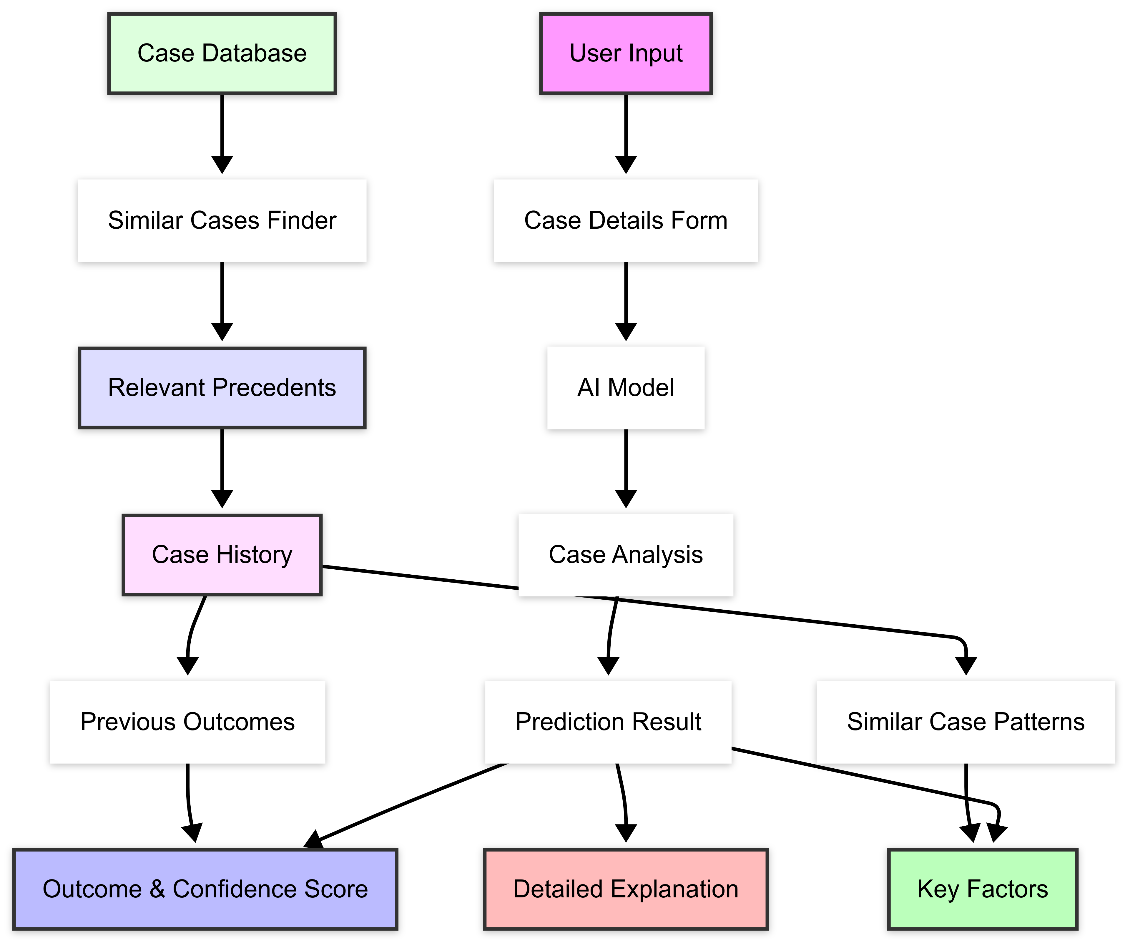
FLOWCHART

Slide 7
TECH STACK
Frontend:
Typescript
React js
Node js
Express js
Dev Tools:
React Hook Form
Zod
Vite
GitHub + Notion
Backend Service & AI:
Gemini API (NLPpredictions)
Supabase PostgreSQL
User Authentication
cases (stores case details)
(sign in/sign up/login)
outcome_explanations (stores predictions and explanations)
prediction_factors(stores factors influencing predictions)
Data Sources:
eCourts Services Portal: ecourts.gov.in
Open justice python library
Legal Databases: National Judicial Data

Slide 8
IMPACT
Informed Decision-Making: Lawyers can use the AI-driven predictions to gain a deeper understanding of the potential outcomes of their cases.
Avoid Unnecessary Trials: Defendants can use the tool to assess the likelihood of conviction or acquittal early in the process. If a conviction seems highly probable, they may opt to settle or negotiate, potentially saving years of litigation and stress.
Scalable Legal Technology: Built with scalable technologies, this system can evolve to handle even larger volumes of case data, expanding to multiple jurisdictions.
Reducing Court Backlog: By predicting the outcomes of cases early, the tool can help prioritize high-value or complex cases that require full hearings, while streamlining cases that are unlikely to succeed, leading to faster resolutions and reducing court backlogs.

